Slide 1
Fluid Network Analysis
Saaketh Ramoju

Slide 2
Goals
Develop an intuition for pressure and flow
Understand relationships between pressure and flow
Learn some of the basic math behind fluid network modeling
Apply conservation laws to solve a system
Differentiate between steady and transient solving methods
Discuss limitations with fluid properties
Explore some unique fluid phenomena

Slide 3
Overview
So that you can follow along as I do the problems, I included a supplementary .mlx containing Matlab code
This code contains the problems I will discuss today
Quick Warmup
Math Concepts
Solving Strategies
Fluid Properties
Fluid Systems
https://github.com/saakethramoju/Fluid-Network-Analysis-Lecture

Slide 4
Warmup

Slide 5
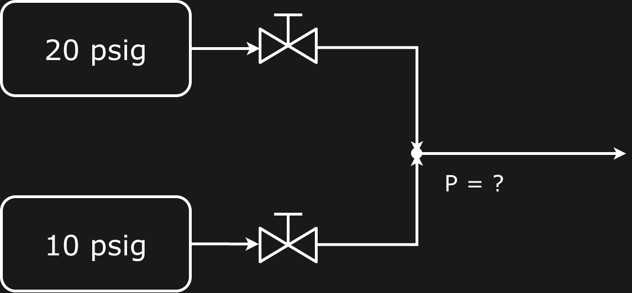
Water
Water

Slide 6
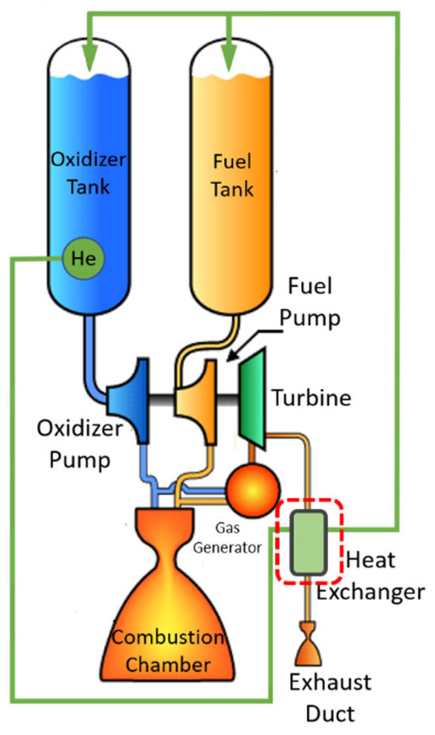
What is a fluid network & why should we care?
A fluid network is form of CFD, computational fluid dynamics
It models system-level parameters
Doesn’t model detailed flow phenomena
A way to combine all your fluid math
Allows for quick iteration and system design without having to set up a costly and time-intensive CFD model of a large system
Especially good when trying to work off of test data from rocket engines or prop systems

Slide 7
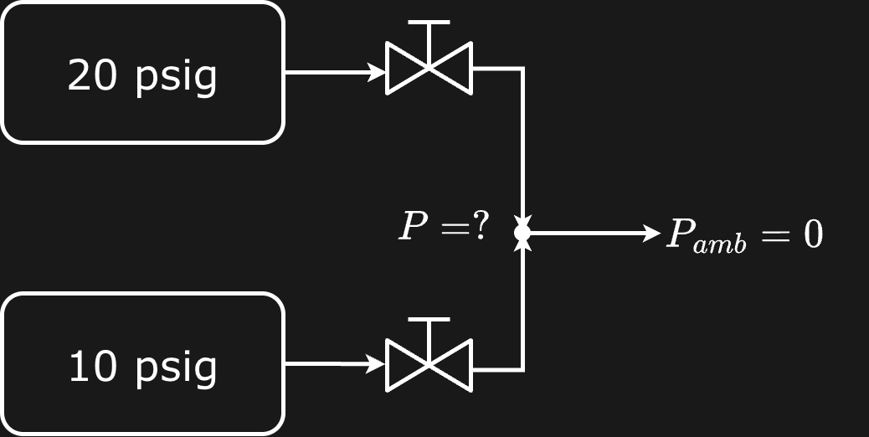
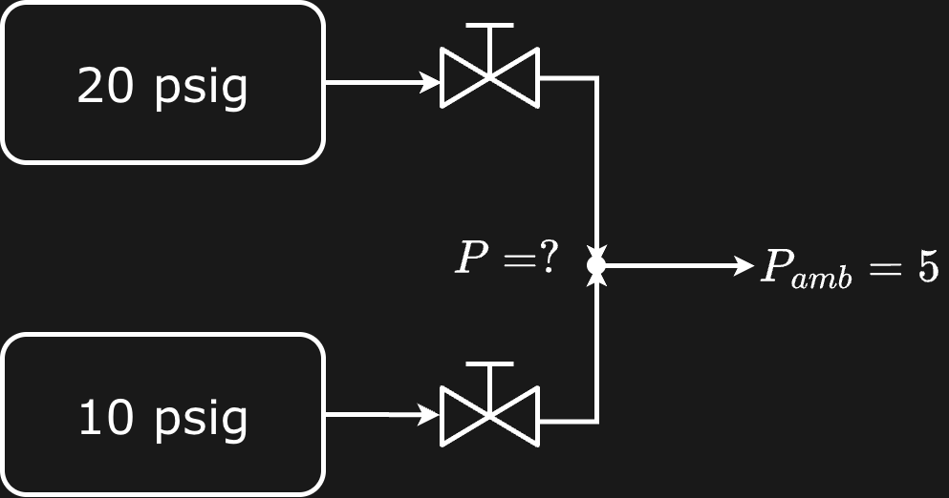
Sea Level
Bottom of a 10ft pool

Slide 8
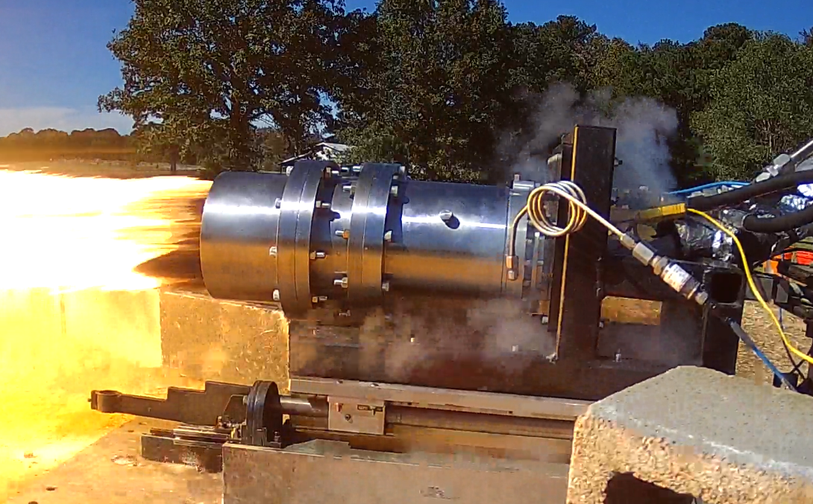
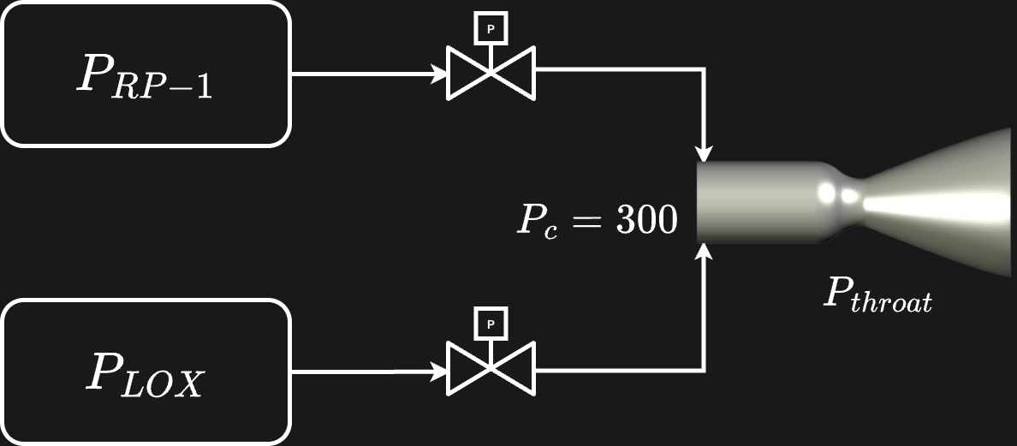
Where does this apply?
How would we increase or decrease chamber pressure?
What if we fixed everything else and decreased Pc?

Slide 9
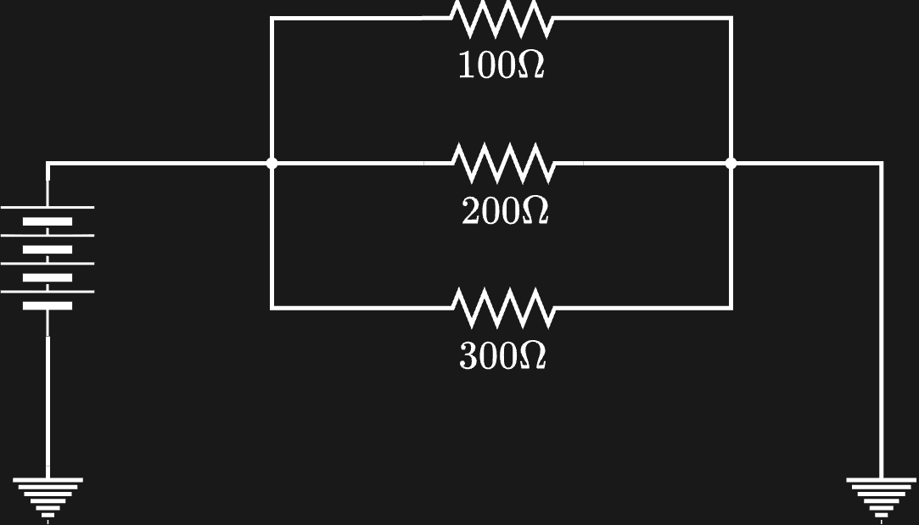
Which branch has the highest current?

Slide 10
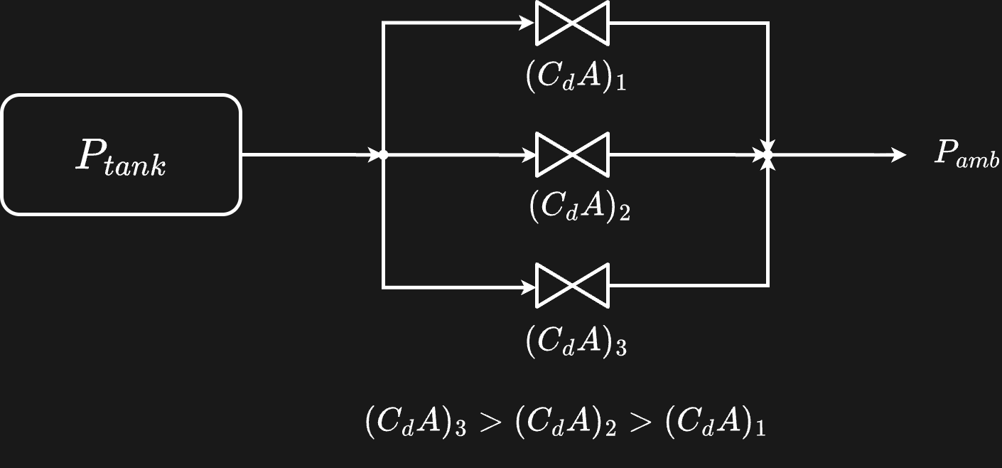
Reapply the same concept
Is there another way to describe fluid resistance other than CdA?

Slide 11
Numerical Methods

Slide 12
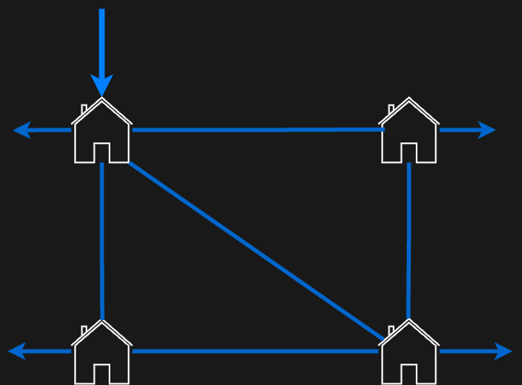

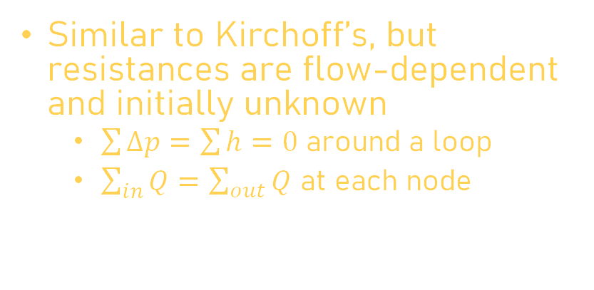



Hardy Cross Method
Old-fashioned method, great for water/hydrualic networks
Good for doing hand calcs
Used by city planners and civil engineers
$$Q_{source}=8 gpm$$
3
$$Q_{demand}$$
$$Q_{demand}$$
1
2
5
$$Q_{demand}$$
$$Q_{demand}=2 gpm$$
4
Similar to Kirchoff’s, but resistances are flow-dependent and initially unknown
$\sum{∆p}=\sum{h}=0$ around a loop
$\sum_{in}{Q}=\sum_{out}{Q}$ at each node
Pipe | L (ft) | d(in) | C
1 | 300 | 6 | 130
2 | 424 | 6 | 130
3 | 300 | 4 | 130
4 | 300 | 6 | 130
5 | 300 | 6 | 130

Slide 13

Hardy Cross Method
Identify CCW loops and guess Q magnitude and direction in each line
Calculate head loss with Q assuming $h_{f}=rQ^{n}$ (head loss)
Hazen-Williams (simpler for water): $r= \frac{4.52L}{C^{1.852}d^{4.8704}}$, $n=1.852$
Darcy-Weisbach (general fluids, hard to find $f$): $r=f\frac{8L}{π^{2}gd^{5}}$, $n=2.0$
Find the Q correction: $∆Q=−\frac{\sum{h_{f}}}{\sum{\frac{dh_{f}}{dQ}}}$, correct each Q.
Iterate until $∆Q$ values are small.
Run the Hardy Cross code section to see it in action

Slide 14
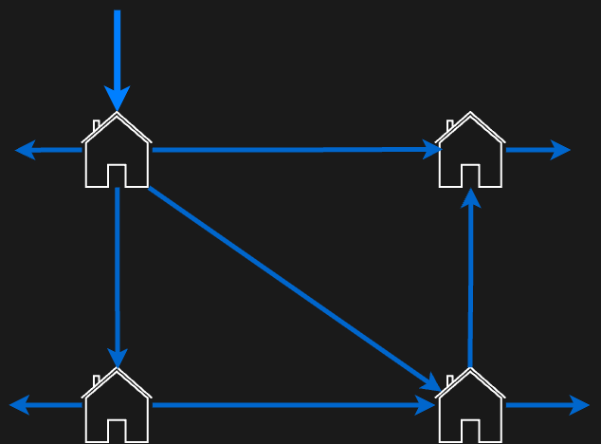
Hardy Cross Method
8
1.03
2
2
2.30
2.67
0.97
0.67
2
2

Slide 15
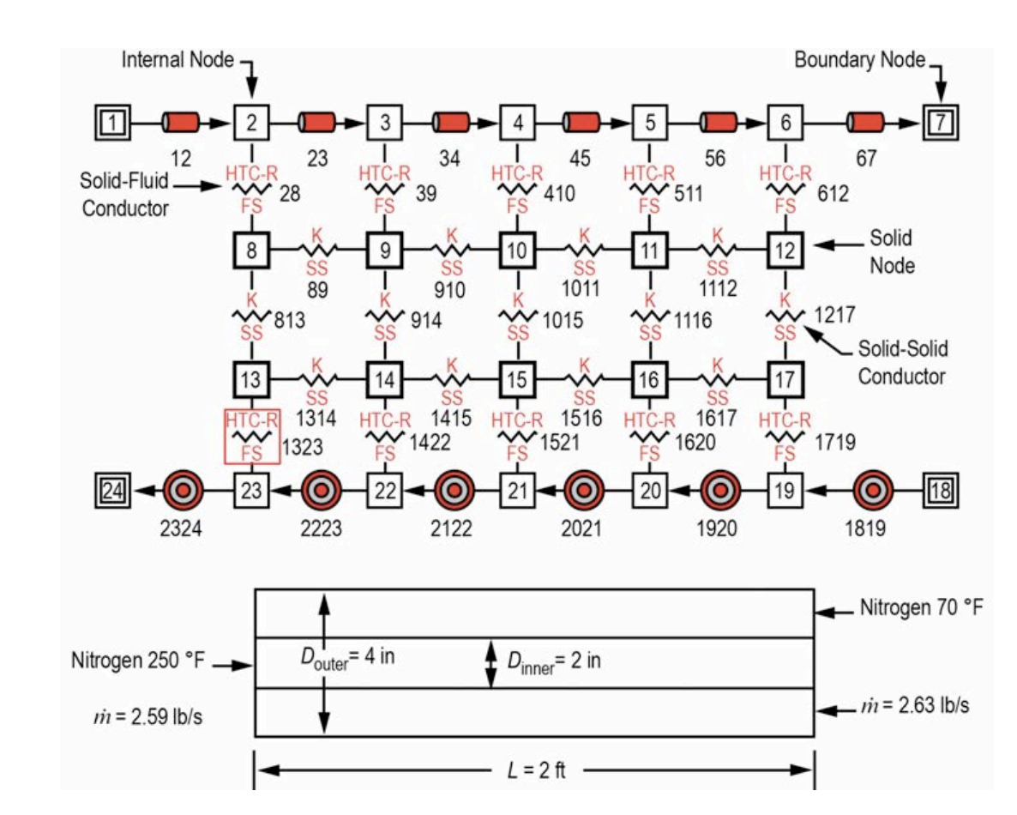
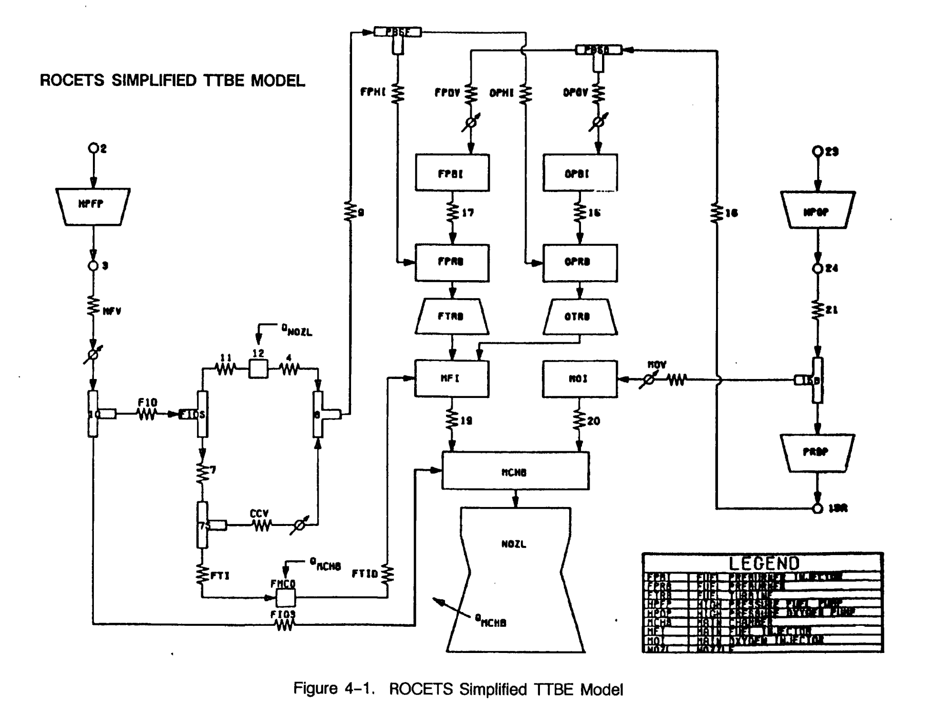
Computerized Models
With computers, Hardy Cross is bad
Computers allow for using normally tedious methods (Newton-Rhapson, Secant, Bisect, etc.)
Hardy Cross only works for steady flow, which is normally fine for simple water/hydraulic networks
Transient models require timestepping
Computers can help model compressible flow, cavitation, valve actuations, temperatures, etc. (stuff you cant do by hand easily)
GFSSP, ROCETs, Modelica, Simcenter Amesim

Slide 16
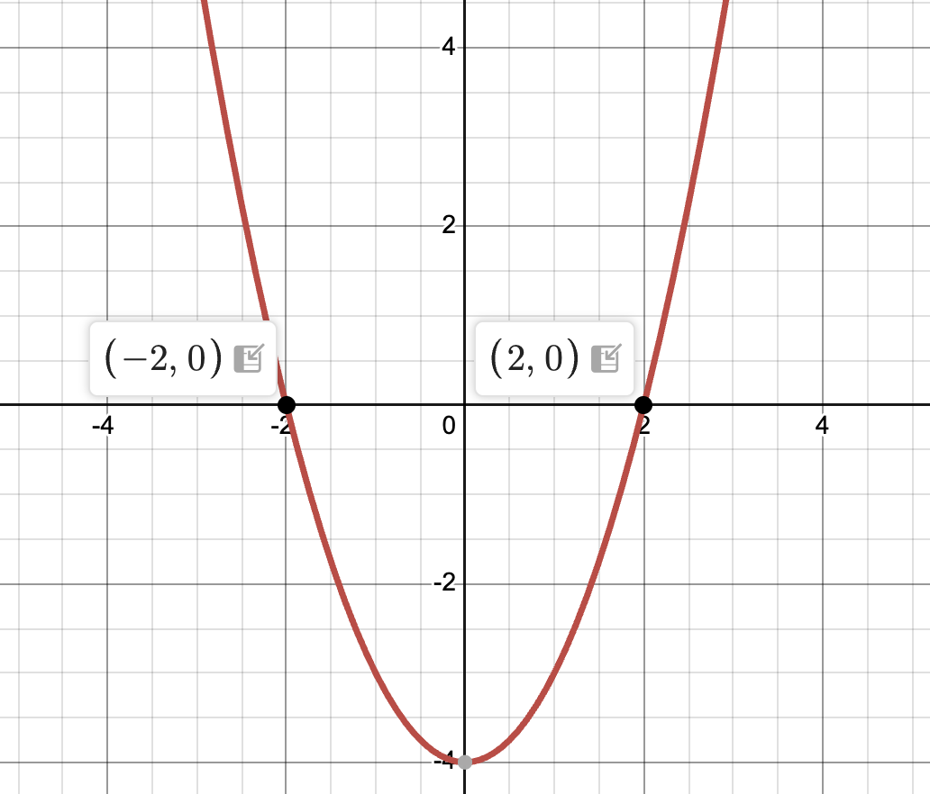
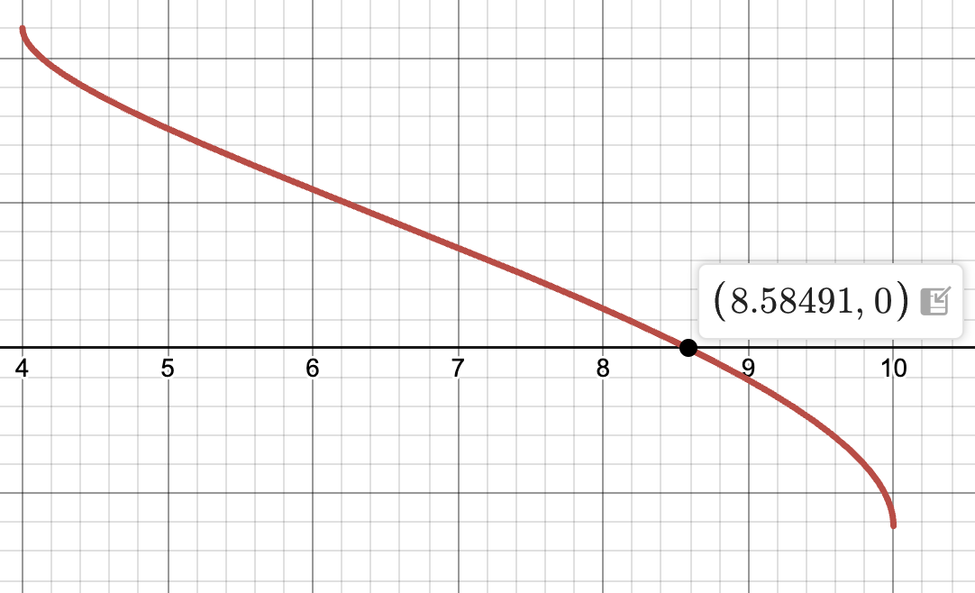


How do we numerically find roots?
For simple functions, finding roots is easy (quadratic formula, Vieta's, etc.)
Have to use root finding methods for heavily nonlinear equations
$${\dot{m}}_{in}−{\dot{m}}_{out}=f\left(P\right)=0$$
$${{{\dot{m}}_{out}=(C}_{d}A)}_{2}\sqrt{2ρ\left(P−P_{amb}\right)}$$
$${{{\dot{m}}_{in}=(C}_{d}A)}_{1}\sqrt{2ρ\left(P_{in}−P\right)}$$

Slide 17
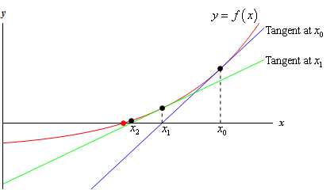
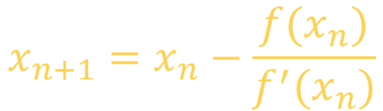
Newton's Method
Pick reasonable starting point
Find the derivative at that point
Find the root of the tangent
Find the new value of the function at that root
Repeat
$$x_{n+1}=x_{n}−\frac{f(x_{n})}{f^{′}(x_{n})}$$

Slide 18
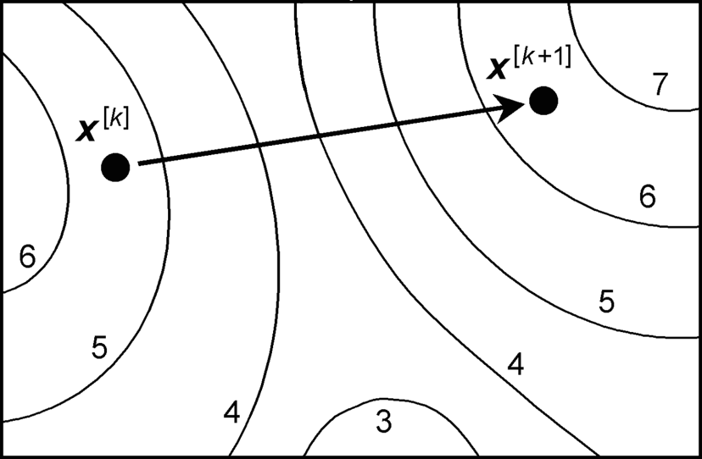
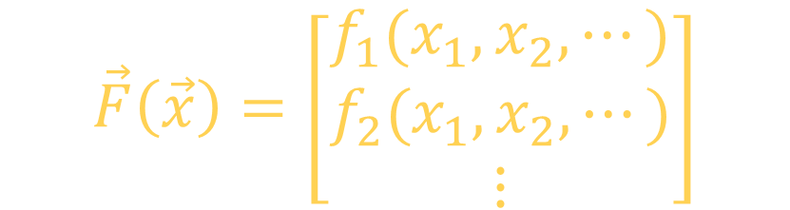
Newton’s Method
What if you have a system of equations?
Each equation is a function of multiple variables
Vector Function:
$$\vec{F}\left(\vec{x}\right)=\left[\begin{matrix}f_{1}(x_{1},x_{2}, ⋯) \\ f_{2}(x_{1},x_{2}, ⋯) \\ ⋮\end{matrix}\right]$$

Slide 19


Newton’s Method
$$J=\frac{∂(f_{1},f_{2}, …)}{∂(x_{1},x_{2}, …)}=\left[\begin{matrix}\frac{∂f_{1}}{∂x_{1}} & \frac{∂f_{1}}{∂x_{2}} & ⋯ \\ \frac{∂f_{2}}{∂x_{1}} & \frac{∂f_{2}}{∂x_{2}} & ⋯ \\ ⋮ & ⋮ & ⋱\end{matrix}\right]$$
You may have seen this before…
Jacobian matrix
It’s important to give a good first guess
Other method’s (e.g. bisect) only need a starting range
scipy is good Python package for these
MATLAB has these built in
(Please use python)
$${\vec{x}}_{n+1}={\vec{x}}_{n}−J^{−1}\vec{F}({\vec{x}}_{n})$$

Slide 20
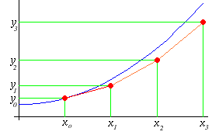
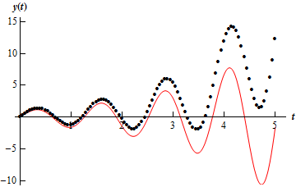
Timestepping
Root solvers are best for steady-state
You give an initial guess, boundary value problems
Most transient (unsteady) solvers are initial value problems
You give starting values, not guesses
The accuracy and ”stability” of time stepping methods really depends on the situation
Again, use scipy

Slide 21
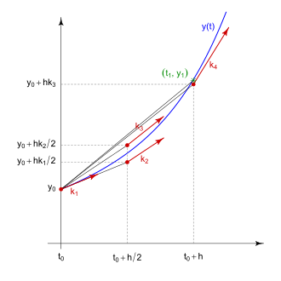
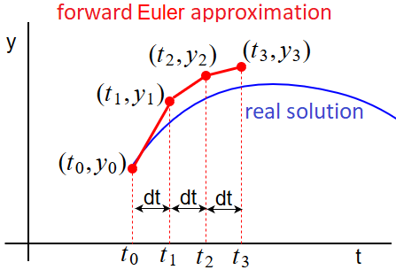
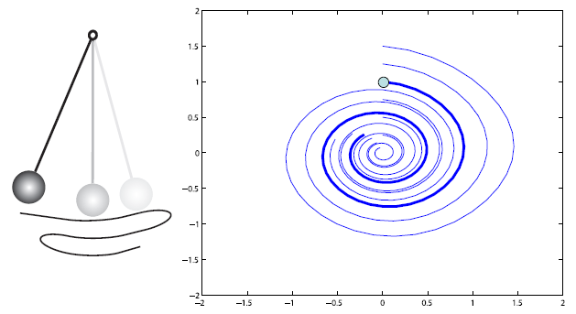
Timestepping
Which method should we choose?
Forward Euler
Backward Euler
Runge-Kutta
Simple, but stable only for a few cases
Unconditionally stable, more computation power
Predictor-corrector method

Slide 22
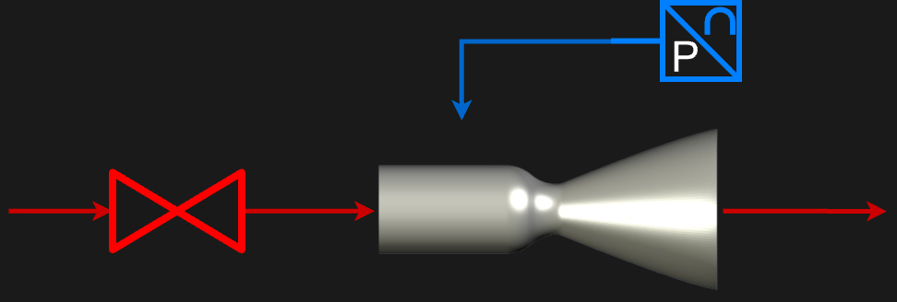

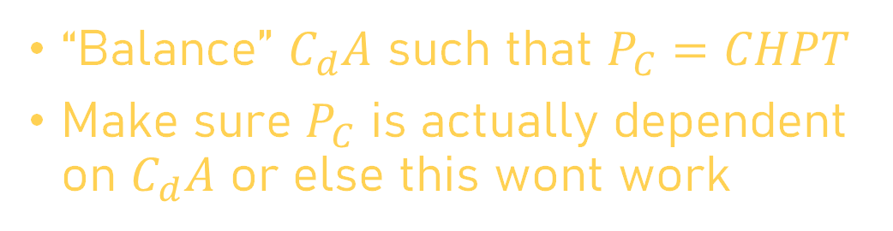


Differential-Algebraic Equations
Sometimes you want to enforce certain property while you iterate or timestep
For example, you have PT data from a test and you want the pressure at a node match the pressure trace over time.
You would need to decouple your pressure value from conservation equations and let it define the system
You have to “trade” a variable to fix one
“Balance” $C_{d}A$ such that $P_{C}=CHPT$
Make sure $P_{C}$ is actually dependent on $C_{d}A$ or else this wont work
$CHPT$
$C_{d}A$

Slide 23
Solving Methods

Slide 24
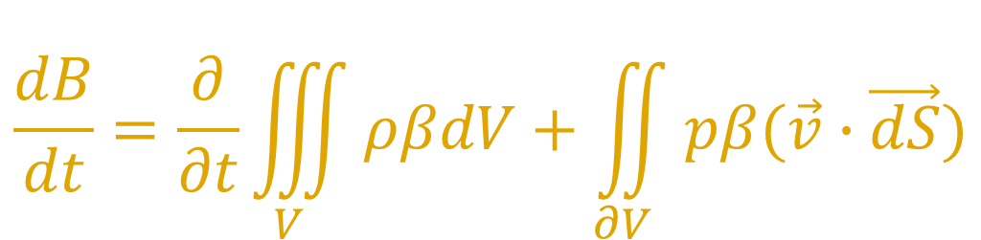
Conservation Equations
For steady flow, what goes in, must come out
For unsteady (transient) flow, we can have buildup or drainage
What are the conservation equations we care about?
$$\frac{dB}{dt}=\frac{∂}{∂t}\iiint_{V}{ρβdV}+\iint_{∂V}{pβ(\vec{v}∙\vec{dS})}$$
(Reynold’s Transport Theorem, Integral Form)

Slide 25
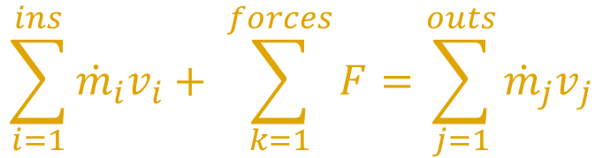
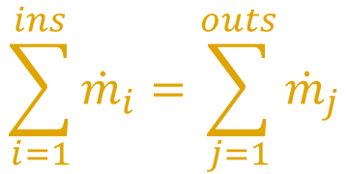

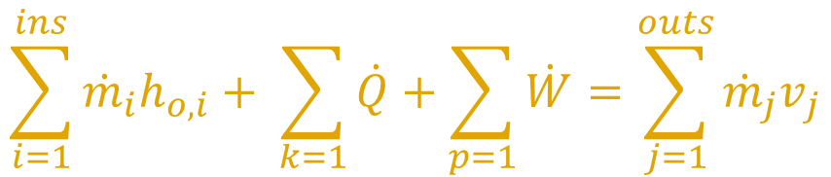
Conservation Equations
$$\sum_{i=1}^{ins}{{\dot{m}}_{i}}=\sum_{j=1}^{outs}{{\dot{m}}_{j}}$$
$$\dot{m}=C_{d}A\sqrt{2ρΔP}$$
For an incompressible “branch”, mass and momentum are used in conjunction to get mdot
$$\sum_{i=1}^{ins}{{\dot{m}}_{i}v_{i}}+ \sum_{k=1}^{forces}{F}=\sum_{j=1}^{outs}{{{\dot{m}}_{j}v}_{j}}$$
$$\sum_{i=1}^{ins}{{\dot{m}}_{i}h_{o,i}}+ \sum_{k=1}{\dot{Q}}+\sum_{p=1}{\dot{W}}=\sum_{j=1}^{outs}{{{\dot{m}}_{j}v}_{j}}$$
How many equations will we need for each node?

Slide 26
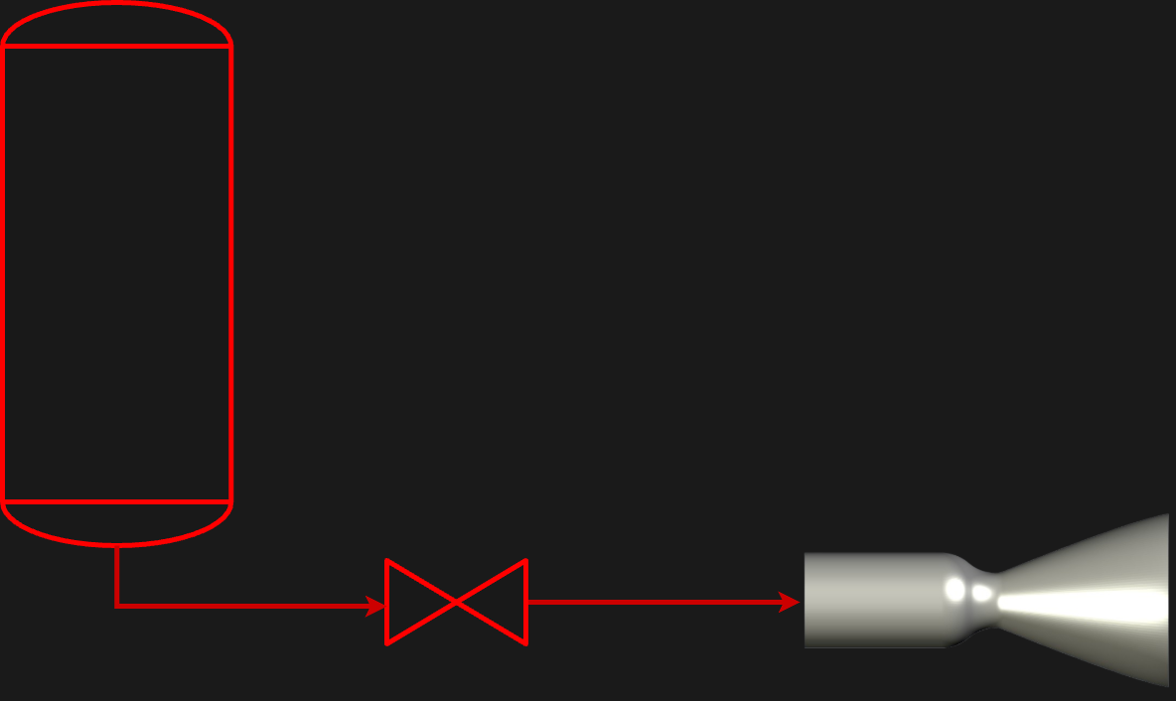




Steady State Flow
How do we “solve” the system?
$$P_{Tank}$$
$$C_{d}A$$
$$P_{c}=?$$
$$P_{amb}$$

Slide 27
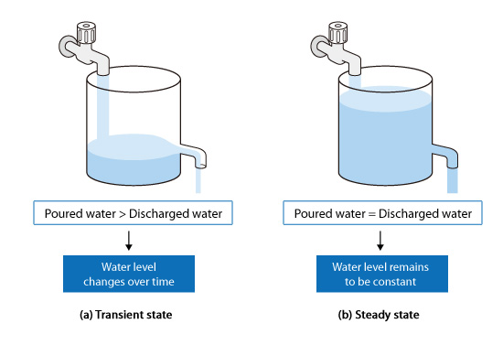

Steady State Flow
Define nodes and branches:
Node: O-Dimensional control volume with a set mass and thermodynamic properties (u, h, P, T, etc.)
Branch: 1-Dimensional control volume that carries flow properties as a state ($\dot{m}$, Q, etc.)
Steady State: properties are time-independent:
We are solving for the set of node properties that the system will exhibit when it has no tendency to change due to internal or external forces

Slide 28

Steady State Flow
Identify your nodes and the node properties you wish to solve for (usually will be pressure and something else)
Set up the residual equations for each node:
$f\left(P\right)={\dot{m}}_{in}\left(P\right)−{\dot{m}}_{out}(P)$
Set all residuals equal to zero and use a root solver to find the value of P and other variables that satisfy the system of equations
Netwon’s Method, Bisect, etc.
You will need to provide initial guesses or brackets for every independent variable

Slide 29





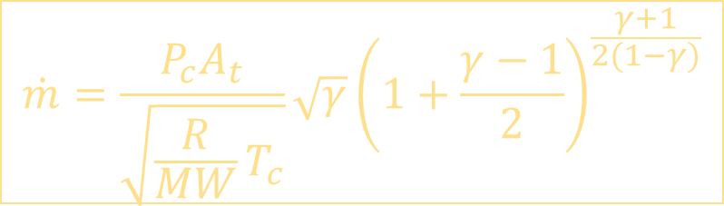








Steady State Flow
$$\dot{m}=\frac{P_{c}A_{t}}{\sqrt{\frac{R}{MW}T_{c}}}\sqrt{γ}{\left(1+\frac{γ−1}{2}\right)}^{\frac{γ+1}{2(1−γ)}}$$
Try to solve for the chamber pressure
$$\dot{m}=C_{d}A\sqrt{2ρ(P_{1}−P_{2})}$$
$$P_{Tank}=400 psia$$
$$T_{Tank}=110 K$$
$${CH}_{4}$$
$$R=8314.46 \frac{J}{kmol∙K}$$
$$ρ_{Tank}=427. 16 \frac{kg}{m^{3}}$$
$$MR=3.2$$
$$A_{t}=5.42 {in}^{2}$$
$$T_{c}=3347.12 K$$
$$MW=20.742$$
$$γ=1.127$$
$$C_{d}=1.0$$
$$P_{amb}=14.7 psia$$
$$C_{d}A=1.11 {cm}^{2}$$
Modify the Steady-State Chamber Pressure Section

Slide 30
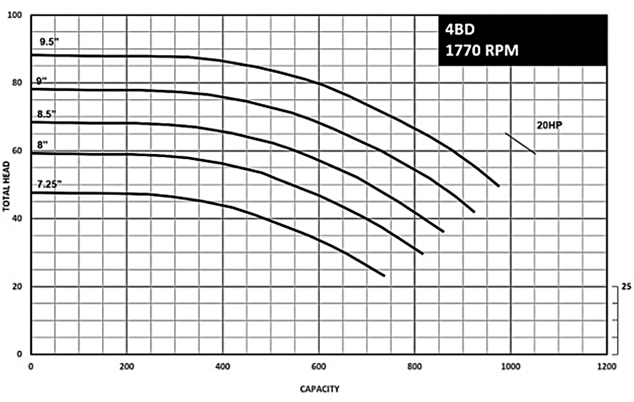
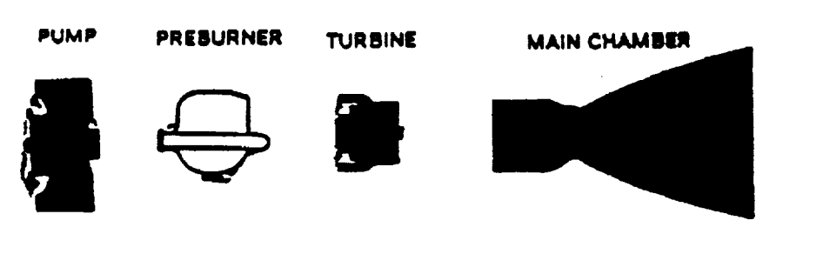
Steady State Flow
Steady flow will be the majority of models you make
It tends to be more accurate, and you often don’t care about the transient behaviour
Things you can model with steady state
TCA performance
Required pressure ladders
Choked flow
Pump operation
“If my tanks have this much pressure, how much thrust will I get?”

Slide 31
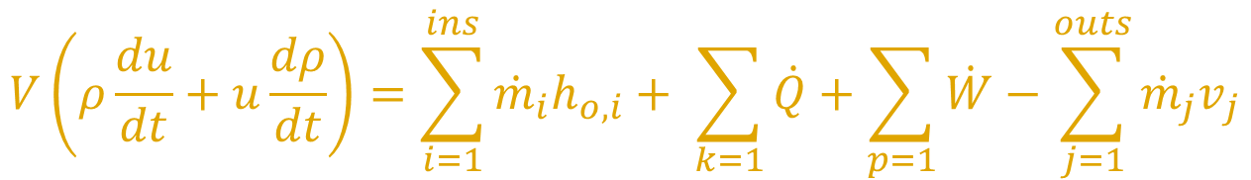

Transient Flow
Unsteady flow requires that we account for the changing bulk value of each node.
For this reason, nodes are assigned a volume corresponding to what they represent in real like (union fitting, TCA chamber, tank, etc.)
Instead of solving residual equations, the mass and internal energy of the nodes are stepped through time
$$V\frac{dρ}{dt}=\sum_{i=1}^{ins}{{\dot{m}}_{i}}−\sum_{j=1}^{outs}{{\dot{m}}_{j}}$$
$$V\left(ρ\frac{du}{dt}+u\frac{dρ}{dt}\right)=\sum_{i=1}^{ins}{{\dot{m}}_{i}h_{o,i}}+ \sum_{k=1}{\dot{Q}}+\sum_{p=1}{\dot{W}}−\sum_{j=1}^{outs}{{{\dot{m}}_{j}v}_{j}}$$

Slide 32

Transient Flow
Define your timestep and initial conditions
Identify your nodes and the node properties you wish to solve for (usually will be pressure and something else)
Set up the differential equations relating to mass conservation and energy conservation:
$M_{new}=M_{old}+∆t({\dot{m}}_{in}−{\dot{m}}_{out})$, $U_{new}=U_{old}+∆t({\dot{m}}_{in}h_{o,in}−{\dot{m}}_{out}h_{o,out})$
Lookup the state variables that give the new density and internal energy for each node

Slide 33
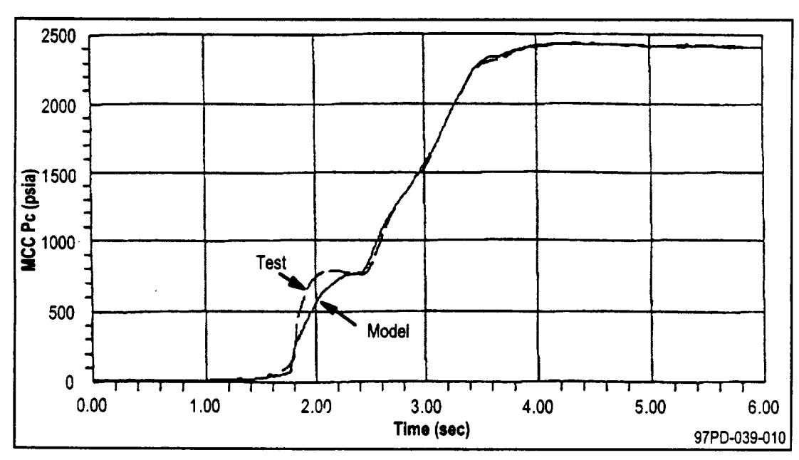
Transient Flow
Very hard to do accurately, but it can be done
Was used for SSME to model chill and engine startup transients, and it was pretty accurate
Things transient models could account for:
Valve sequencing
Fluid hammer
Throttling (Open Ratio vs Cd curve needed)
“When I open my valve, what does the mass flow look like over time?”
Transient models can be accurate, but there will always be phenomenon that are difficult to model or simply not worth modeling.
In this SSME model, for example, main chamber pressure deviates due to unpredictable preburner and turbopump behavior

Slide 34
Fluid Properties

Slide 35
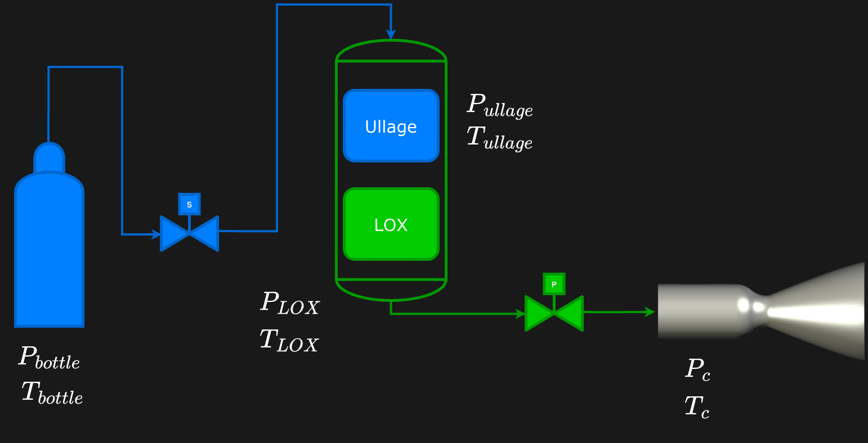
What properties are needed?
State Postulate!
Do you foresee any issues with trying to iterate pressure and temperature?

Slide 36
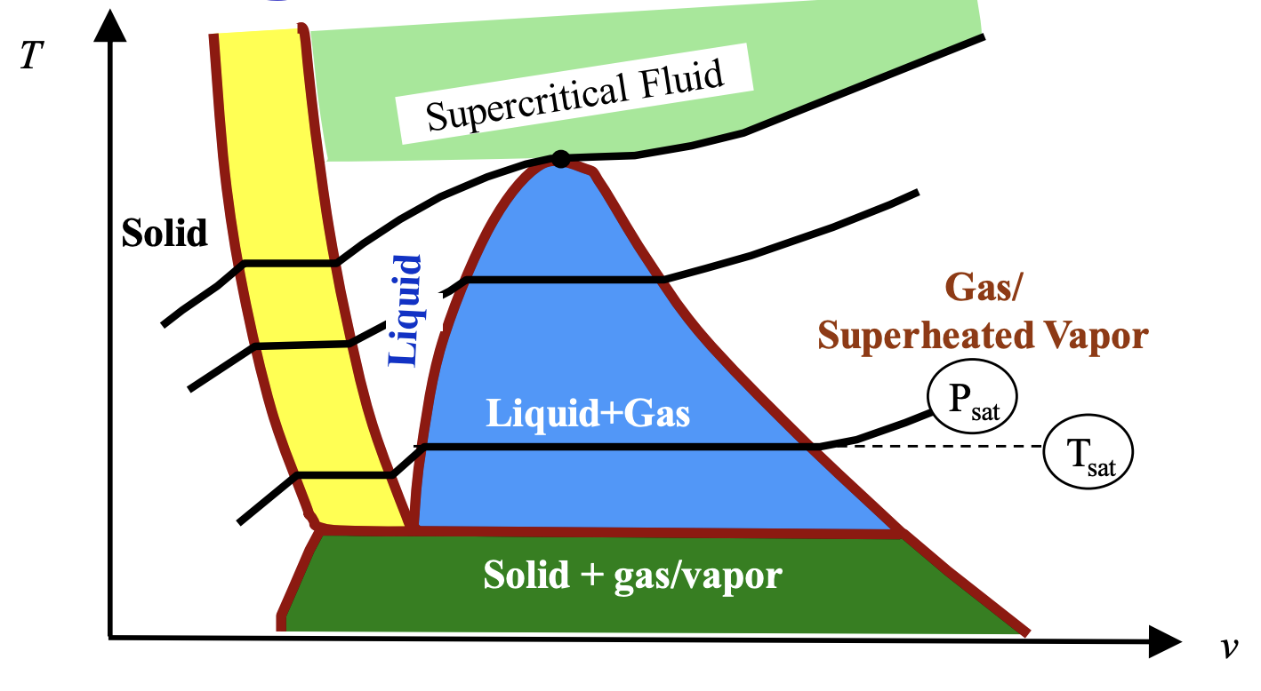
Fluid Phases
In the vapor dome (saturated region), pressure and temperature are not independent.
As phase change from liquid to gas, the pressure and temperature stay constant.
A single pressure and temperature combination can yield multiple internal energies.
Iteration over temperature can also be numerically unstable due to the ratio of residual sizes
These issues are solved by iterating over P and h instead

Slide 37
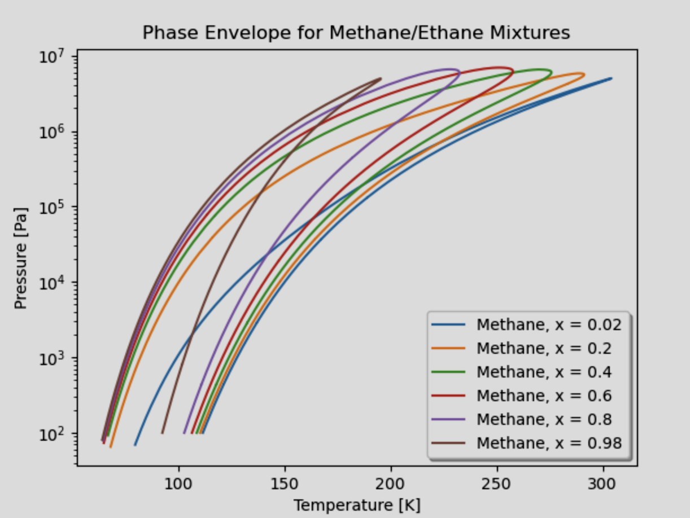

Mixtures
For every new component/species to a fluid mixture, a new degree of freedom is added (mass fraction: $Υ_{i}$)
Just two TD properties are no longer enough
This also means just two conservation equations are not enough
Species conservation must also be introduced
Assume that the fluid is non-reacting: $\sum_{i=1}^{ins}{{\dot{m}}_{i}Υ_{i}}=\sum_{j=1}^{outs}{{\dot{m}}_{j}Υ_{j}}$
Not all mixtures are ideal gases!
For real fluid mixtures, it’s not as simple are just taking weighted averages to find specific volume, enthalpy, etc.
Mixture modeling is usually one of the biggest hurdles for generalized fluid networks

Slide 38




Fluid Lookups
Making a generalized fluid network means having access to digitalized fluid properties
For steady state, lookups need to be able to give any properties with pressure enthalpy
For transient, you may need lookups with density, entropy, etc.
CoolProp is great for purefluids, but not good for mixtures (including air)
Coolprop also has a limited mixture database, mostly limited to binary mixtures
REFPROP is way better, but is harder to use and costs $325
NIST is handy for quick manual lookups
BEWARE! Not all NIST chemicals share the same reference enthalpy, so do not blinding mix values without checking formation enthalpies
Cantera or Thermo are good if you want to define your own fluids, but otherwise they’re limited in Equation-of-State (EOS) capabilities
Getting RP-1 properties can be a challenge
Use n-Dodecane in CoolProp/REFPROP
Use RocketProps

Slide 39
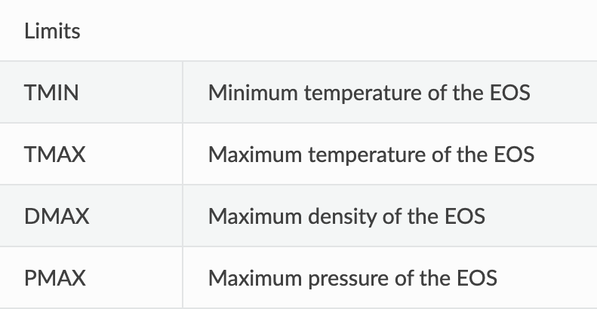
Fluid Lookups
Can be super annoying with solvers
Iterative solvers need freedom to try a wide range of points
In-built solver often automatically calculate the partial derivatives in Jacobians by plugging in values a bunch of values and subtracting them
REFPROP enforces data limits
Online packages like CoolProp have limits to that available T and P ranges of fluid data, so the solver may throw errors
SOLUTION 1: program the residual to be very high if P or T is outside the bounds
SOLUTION 2: allow the solver to extrapolate values

Slide 40
Fluid Systems

Slide 41
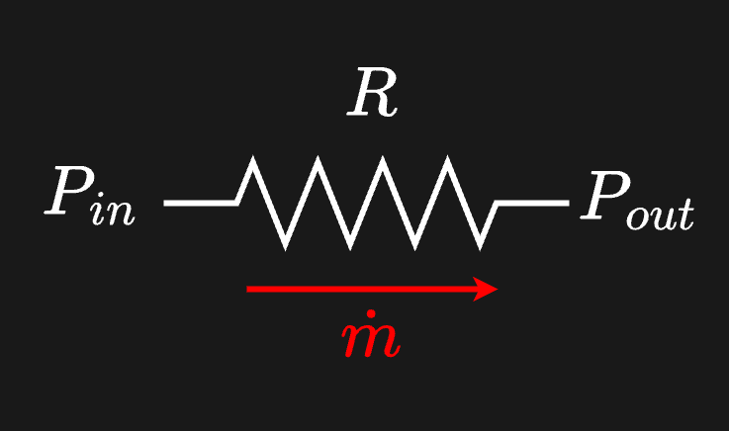
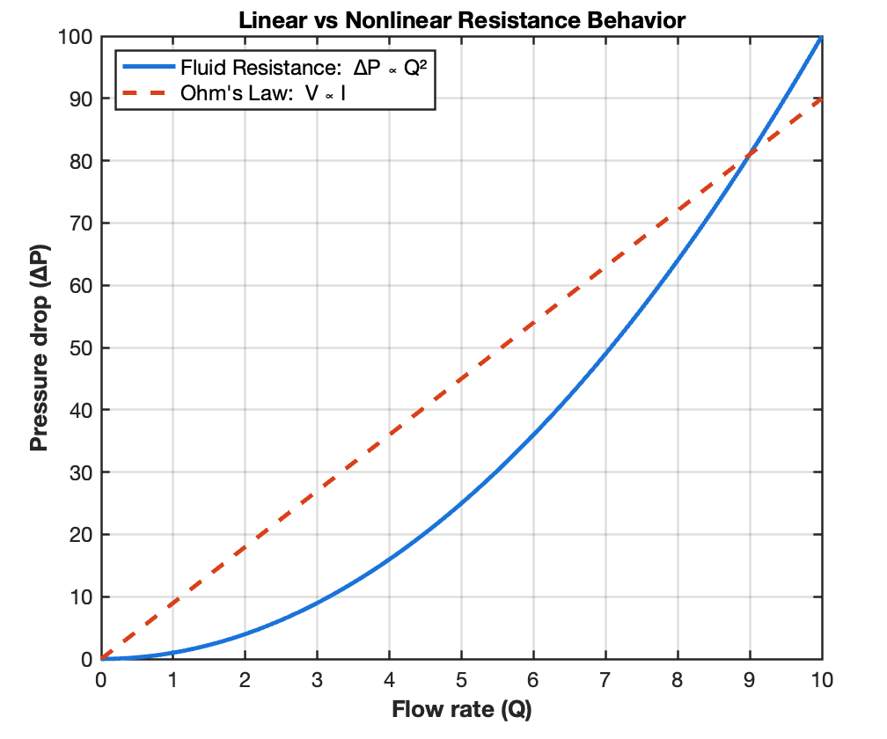

Resistance
You have already seen mathematical relations for resistance:
$Q=C_{d}A\sqrt{\frac{2∆P}{ρ}}=A\sqrt{\frac{2∆P}{ρK}}$ or $\dot{m}=C_{d}A\sqrt{2ρ∆P}=A\sqrt{\frac{2ρ∆P}{K}}$
How much energy does a fluid need to expend to sustain a certain flowrate: $∆P=R\dot{m}$, where $R=f(\dot{m}, ρ, …)$
This is usually a steady state property, it is independent of any time derivatives
CAREFUL: The form we have here is referred to as pneumatic resistance, you may also see hydraulic resistance ($∆P=RQ$)
Analogous to Ohm’s Law: $V=RI$
Flow resistance is nonlinear
Can easily do parallel/series flow calcs in the same way

Slide 42







Resistance
Parallel Network
Relation to CdA
$${\dot{m}}^{2}={\left(C_{d}A\right)}^{2}2ρ∆P$$
$$R=\frac{\dot{m}}{2ρC_{d}A}$$
(NASA Definition)
$$\frac{1}{R_{Total}}=\sum{\frac{1}{R_{i}}}$$
$$R=ρ\frac{∆P}{{\dot{m}}^{2}}$$
$$R=\frac{1}{2{\left(C_{d}A\right)}^{2}}$$
Similar to the $h=RQ^{2}$ definition from earlier. Head is often proportional to $Q^{2}$ or ${\dot{m}}^{2}$, so it’s helpful to redefine R

Slide 43

Resistance
Other Familiar Forms
$∆P=R{\dot{m}}^{2}$form ($N$ accounts for units)
Incompressible Flow Coefficient: $R=\frac{N}{ρρ_{water}C_{v}^{2}}$
Unchoked Swagelok Equation: $R=\frac{NT_{1}}{ρρ_{air}C_{v}^{2}P_{1}{\left(1−\frac{2∆P}{3P_{1}}\right)}^{2}}$
Choked Swagelok Equation: $R=\frac{NT_{1}}{(0.471)ρρ_{air}C_{v}^{2}P_{1}^{2}∆P}$
Reader-Harris/Gallagher (for orifices): $R=\frac{8\left(1−β^{4}\right)}{C_{d}^{2}ε^{2}π^{2}d^{4}ρ_{1}}$
The compressible Swagelok equations and Reader-Harris Equations are equivalent to using the flow parameter $f(γ, M)$

Slide 44


Capacitance
Capacitance represents energy storage capability of a flow component:
For a compressible fluid, energy can be stored in compression too
Imagine an accumulator or a tank with an inlet and outlet
This is a transient property, it depends on the time derivative of pressure
${\dot{m}}_{in}−{\dot{m}}_{in}=C\frac{dP}{dt}$
This is analogous to an electrical capacitor, except this stores pressure instead of charge ($I=C\frac{dV}{dt})$
Capacitance is accounted for in Node conservation
What’s the capacitance, C, of this fluid component?

Slide 45


Capacitance
$$P_{tank}=P_{amb}+ρgh$$
$$\frac{dP_{tank}}{dt}=ρg\dot{h}$$
$${\dot{m}}_{in}−{\dot{m}}_{out}=ρA\dot{h}$$
$$C=\frac{ρA\dot{h}}{ρg\dot{h}}=\frac{A}{g}$$

Slide 46


Inertance
Represents the extra energy needed to accelerate a fluid from it’s current flowrate: $∆P=L\frac{d\dot{m}}{dt}$
This is a transient property of a flow branch
Similar to an inductor ($V=L\frac{dI}{dt}$). For this reason, inertance is also referred to as inductance.
Restatement of Newton’s Second Law (unsteady Reynolds Transport):
$F_{inertial}=A∆P=\frac{d}{dt}\left(Mv\right)=ρAl\frac{1}{ρA}\frac{d\dot{m}}{dt}$ → $∆P=\frac{l}{A}\frac{d\dot{m}}{dt}=L\frac{d\dot{m}}{dt}$ → $L=\frac{l}{A}$
The inertia is the fluid’s mass, resisting the need to accelerate
Density is variable for compressible flow
Again, this form is referred to as pneumatic inductance.
Hydraulic inertance would be $L=\frac{ρl}{A}$

Slide 47


Pressure/Flow Sources
Pressure Sources:
Provide a constant source of driving $∆P$
Magical tank that maintains the same head pressure
Roughly what a centrifugal pump does, for a fixed downstream resistance
Flow sources
Provide a constant source of Q or $\dot{m}$
Roughly what a positive displacement pump does, assuming fixed downstream resistance

Slide 48










Transient Mass Flow
Approximately how long does it take for the $\dot{m}$ through this line to reach steady-state? (assuming ${\dot{m}}_{t=0}=0 kg/s$)
You may assume CdA remains constant
$$R=\frac{1}{2{\left(C_{d}A\right)}^{2}}$$
$$L=\frac{l}{A}$$
$$P_{tank}=100 psig (remains constant)$$
$$\frac{d\dot{m}}{dt}=(∆P−\frac{R}{ρ}{\dot{m}}^{2})\frac{1}{L}$$
$$P_{amb}=0 psig (remains constant)$$
$$C_{d}=0.8$$
$$l=10 m$$
$$A=10 cm^{2}$$
Forward Euler :
$${\dot{m}}_{new}={\dot{m}}_{current}+\frac{d\dot{m}}{dt}∆t$$
Fix the Transient Mass Flow Section in the code

Slide 49

Transient Mass Flow
Roughly ~1.4 seconds!

Slide 50


System Curves
$$H=RQ+ \frac{1}{C}\int{Q}dt+L\frac{dQ}{dt}$$
Represent the head vs flowrate of an entire fluid system
Usually for steady flow
Usually these curves have to be determined experimentally
This is what a pump curve is, just a for a single component
A balanced fluid network model can easily determine the resistances, inductances, and capacitances for every node an branch in your system, allowing you to extrapolate points on the system curve
Analogous to an RLC circuit
Different steady state system curves for varying resistance. Which one has the lowest resistance?

Slide 51
Fluid Phenomena

Slide 52


Fluid Hammer
When a fluid is brough to rest suddenly (usually through valve closure), the sudden accumulation of mass causes a pressure spike
This spike oscillate through the system and can be modeled as a partial differential equation.
This is a transient phenomenon
The peak magnitude of the spike can be modeled with the Joukowsky Equation:
$∆P=ρa∆v$
$a$ is the speed of sound in an incompressible fluid, which is given by $a=\sqrt{\frac{B}{ρ}}$ ($B$: Bulk Modulus)

Slide 53





Combustion
Usually done as fixed volume process
Important to account for formation enthalpy and sensible enthalpy as bonds will break and reform
$h_{o}=∆h_{f}^{°}\left(T_{ref}\right)+\left(h\left(T\right)−h\left(T_{ref}\right)\right)+ \frac{1}{2}v^{2}$
$$\frac{dρ}{dt}=\frac{{\dot{m}}_{1}−{\dot{m}}_{2}}{V}$$
$$ρ\frac{du}{dt}+u\frac{dρ}{dt}=\frac{{\dot{m}}_{1}h_{o,1}−{\dot{m}}_{2}h_{o,2}+\dot{Q}}{V}$$

Slide 54



Cavitating Flow
Sometimes flow can go so fast that its pressure drops below its saturation pressure
It starts boiling, forming gas bubbles
This phenomenon is purposefully caused in a cavitating venturi to decouple the mass flow from downstream pressure
Usually designed to have 15-20% $∆P$ for margin
$$Recovery Factor= \frac{P_{2}−P_{sat}}{P_{1}−P_{sat}}$$

Slide 55
Thanks!

